Slide 1
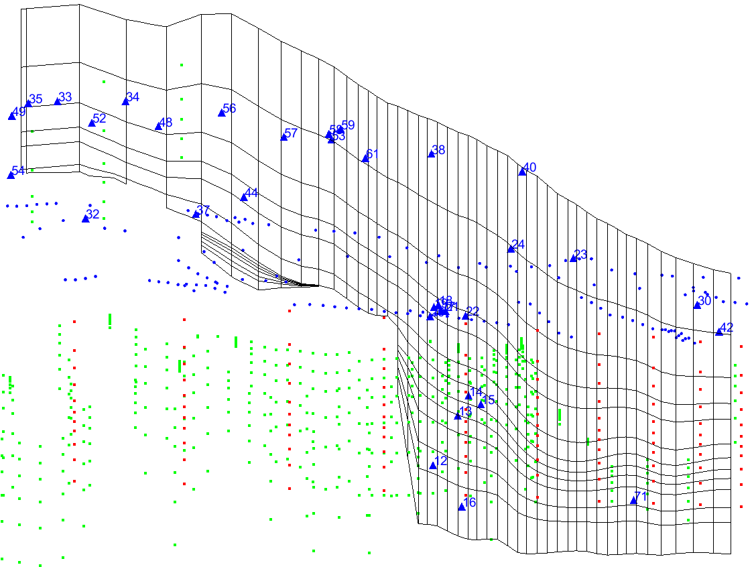
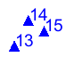

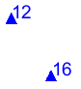

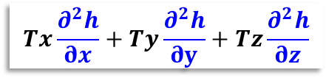
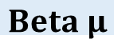
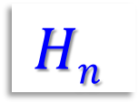
Take a look at this 800 x 800 x 50 m
( ~ 25 m² 50.000 cells)
… cross section
1, 6, 12 Top & lower
numerical layers
Boundaries:
DRN GHB CHD
Well Heads
positions
Vertical discretization
12 layers
MODFLOW
$$Tx\frac{∂^{2}h}{∂x}+Ty\frac{∂^{2}h}{∂y}+Tz\frac{∂^{2}h}{∂z}$$
$Flux$
$$Hn$$
?
Heads
H₂O
An issue
$$Beta μ$$
Notes:
The client has a solid database.
…
Nevertheless, his extensive set of site specific information proclaims, peremptorily, a very consistent “unusual” flow pattern:
- “There appears to be both an apparent rising and falling of groundwater flux at the same time, for the same location”. How is it possible?
A numerical model has have to be built in order to find clues to explain this situation.
…
First hypothesis: - The exhibition of a truly artesian expression at the lower portions of the scrutinized area.

Slide 2
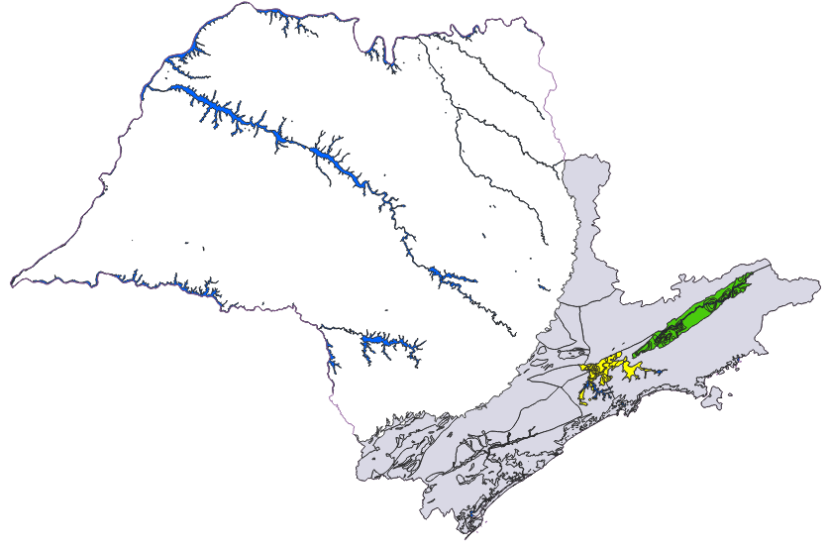
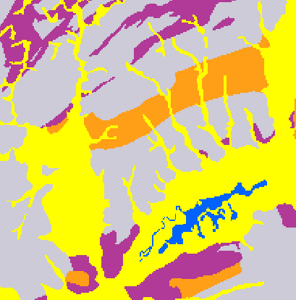
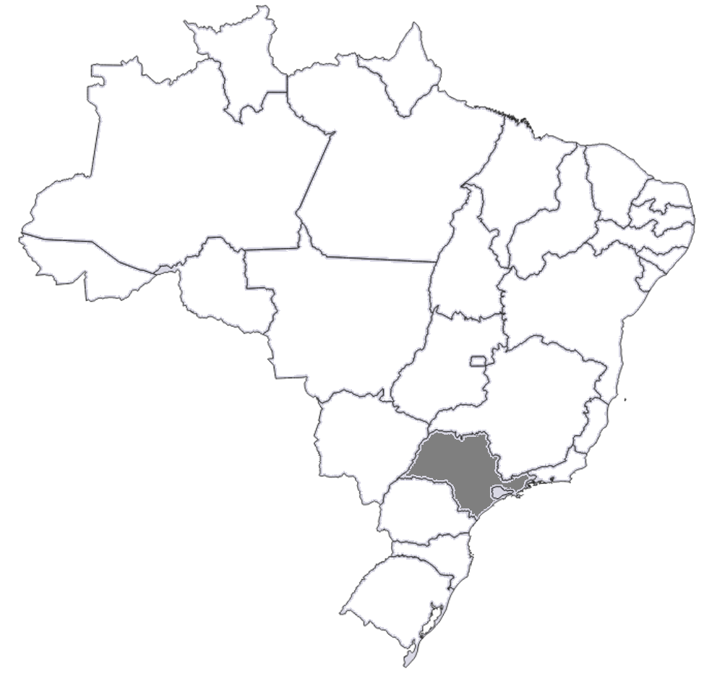
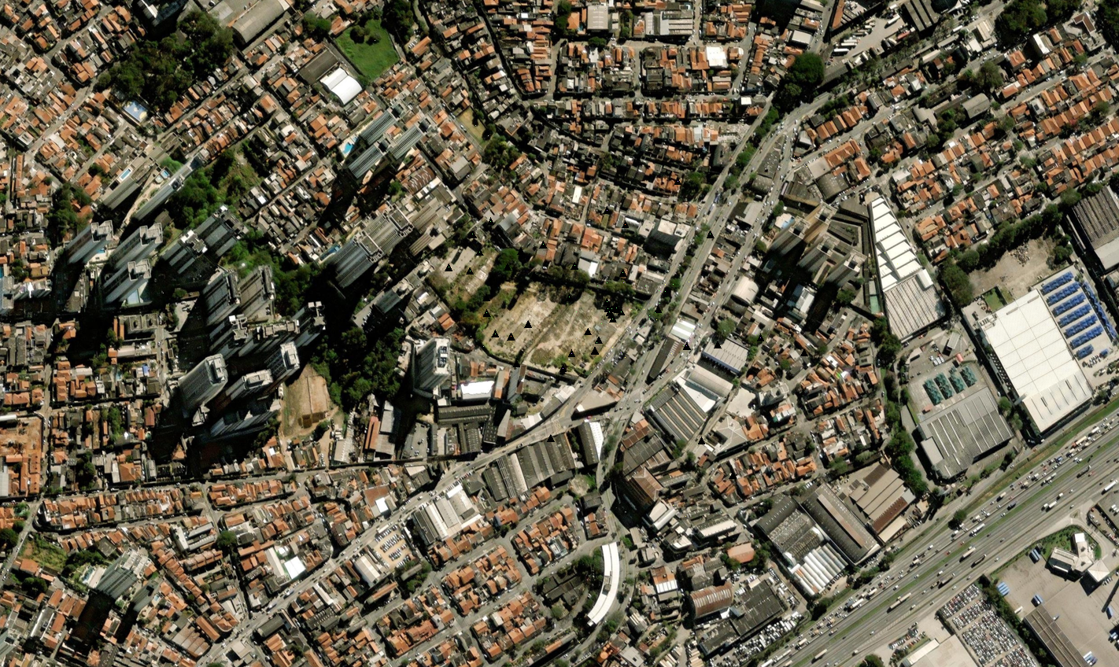
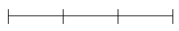
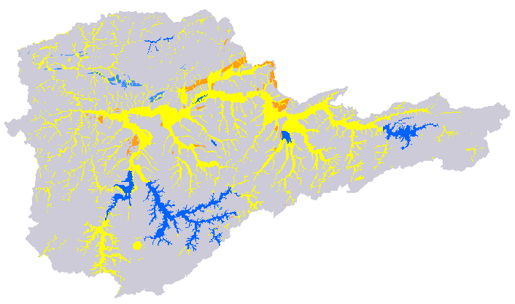
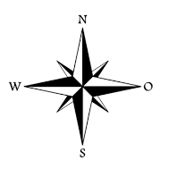
CRSB
Rift
Vale do Paraíba e São Paulo correlated sedimentary Basins
2
x’
y’
4
NE-SW
0 100 200 300
5
km
1
3
Guarulhos
São Paulo
Brazil
N
Upper Tietê river basin
W
E
0 5 10 15
km
S
$$Beta μ$$
Notes:
This is not a ordinary place:
It sits just a couple of meters apart from the Brazilian busiest highway, an urban portion of the Rodovia President Dutra at Guarulhos (GRU), São Paulo.
- Let's look at two of this location's most notable geologic characteristics:
1st: The NE-SW deposition direction of these old sediments from – The Continental Rift of Southeastern Brazil (CRSB Riccomini, 1990) – Twin basins in x’.
2nd: And the perpendicular NW-SE deposition direction for the most recent erosional scenario, driven by the weathering of the current hills in y’.
…
Above and beyond, how can we access a porous aquifer behavior not taking in consideration its main sedimentological aspects?

Slide 3
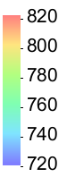
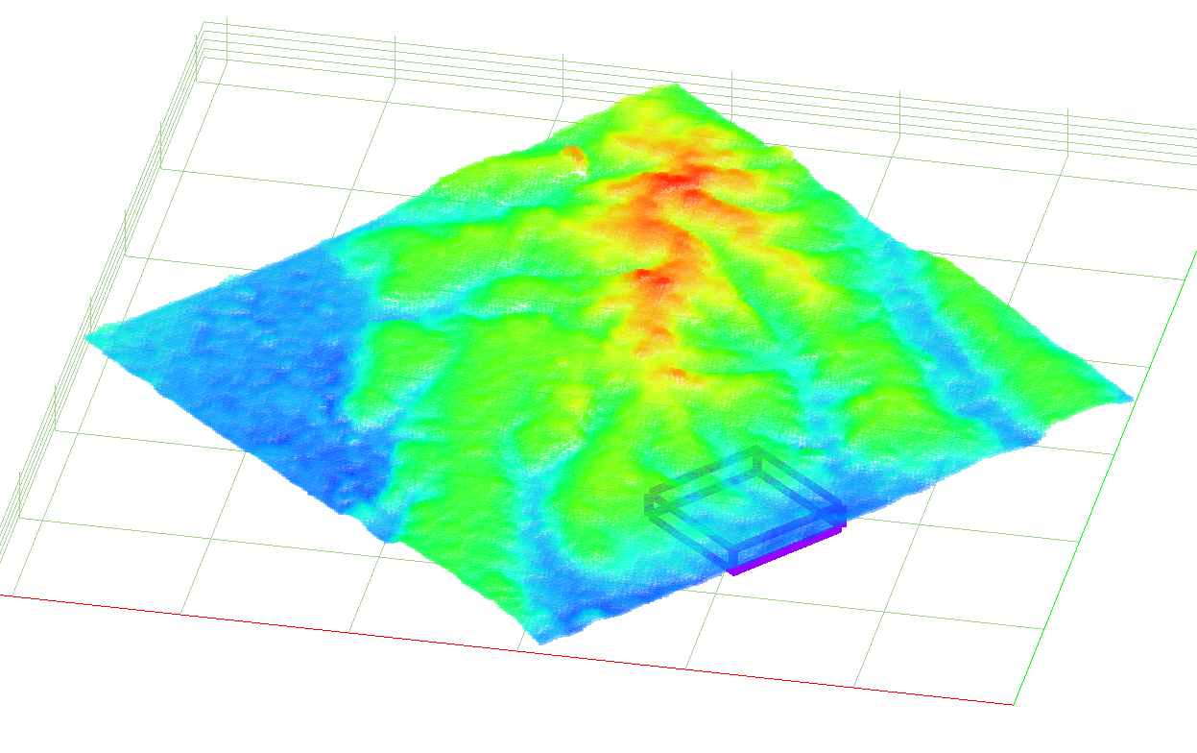
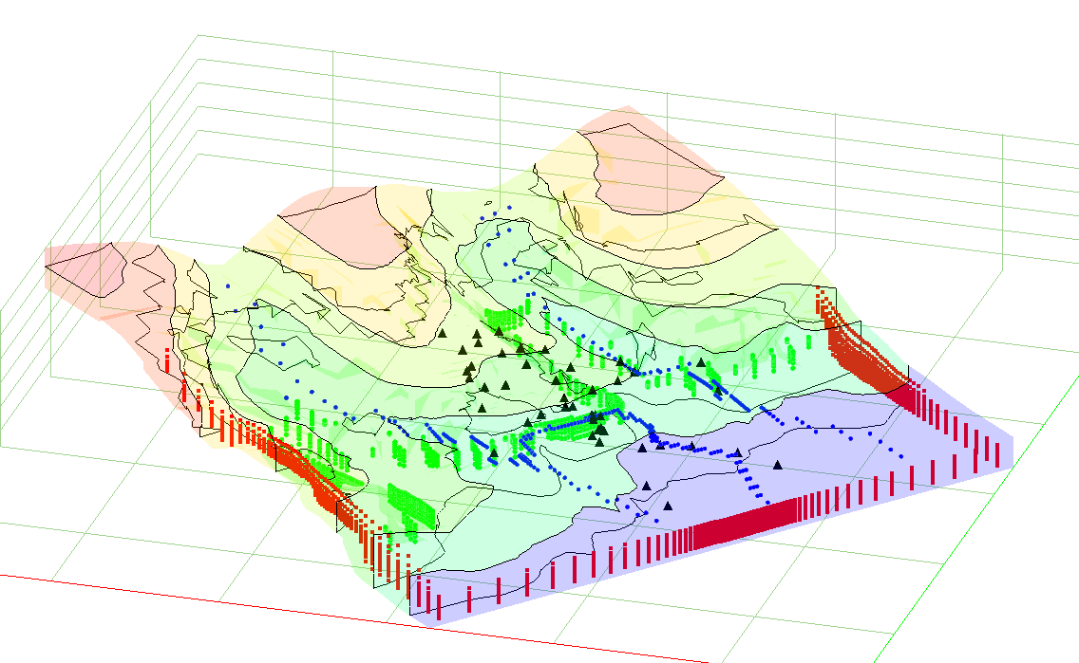
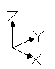
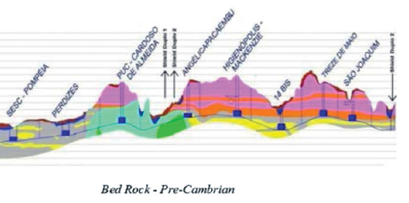
1
Min. 05 m (z) ↕
2
NW-SE cross section
3.5 Km
NE-SW
Main depositional direction
800 x 800 m (x,y)
Max. 50 m (z) ↕
NW-SE cross section
Tertiary Sediments of São Paulo Formation
PUC - Cardozo de almeida
Angélica PACAEMBU
Mackenzie
13 de maio
Sandy clay motled / red
Clayed sand motled
S. Joaquim
Sesc Pompeia
14 Biz
Tertiary Sediments of Resende Formation
Perdizes
Gray silty clay
Gray and yellow silty sand
bedrock
Geological Conceptual Model
H. C. Rocha/M. Comulada /U. Maidl /C. H. Turolla Maia ·
São Paulo Metro – developments in shield tunnelling
$$Beta μ$$
Notes:
The database must be respected. But… so mush so, it is also good to honor the conceptual model.
…
Thus we can expect the interaction of two groundwater flow patterns:
- The main one, since time immemorial, the groundwater flow direction following the original NE-SW (x’) Tietê River channel;
- And a flow pattern arriving from an 3.5 Km distant watershed top divide – assisted by a consistent 100 m gradient – the groundwater flowing the complementary y’ axis direction.
…
Sure enough, the local flux rightly within this very tinny modelled area, as in any discharge region of its kind, must be ascendent, from the aquifer to the river above.

Slide 4
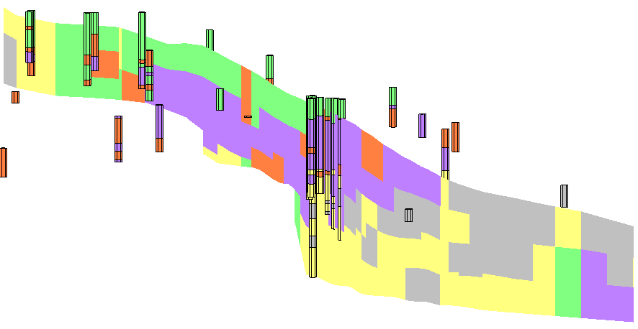
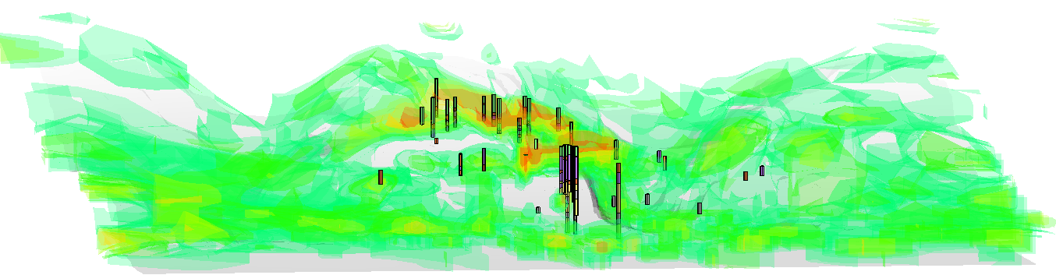
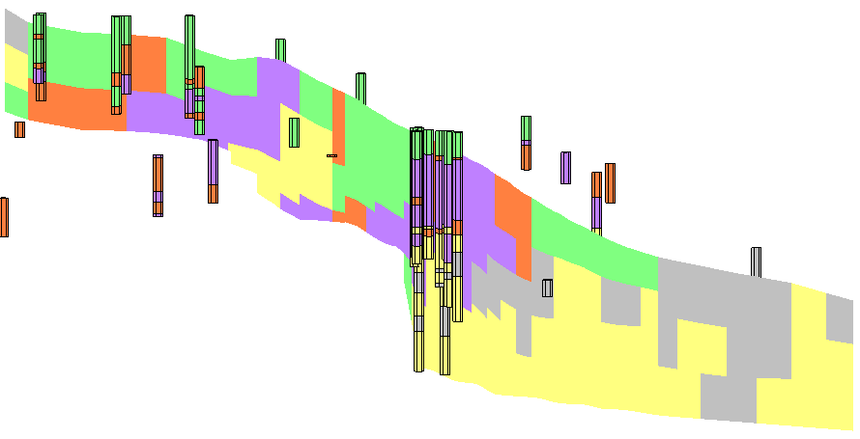
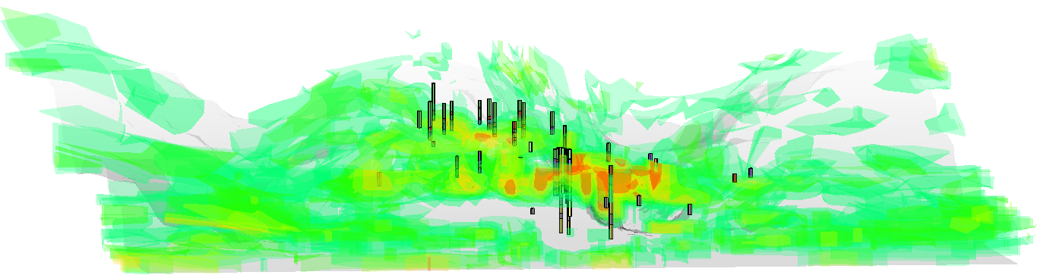
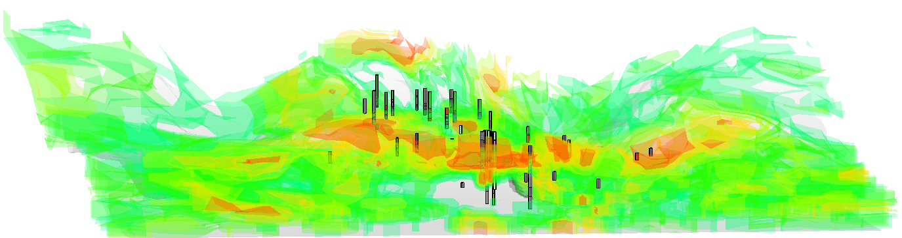
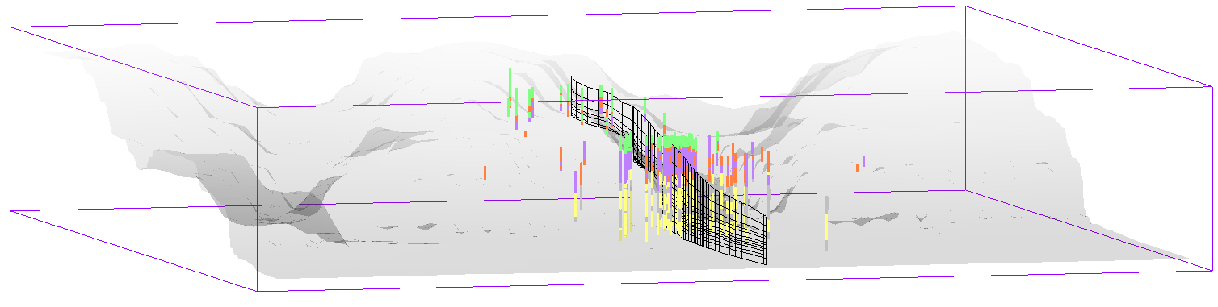
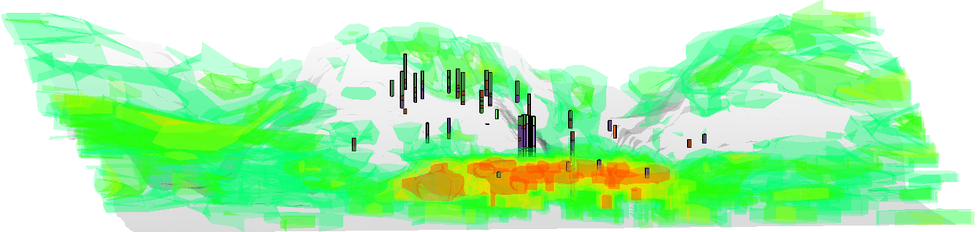
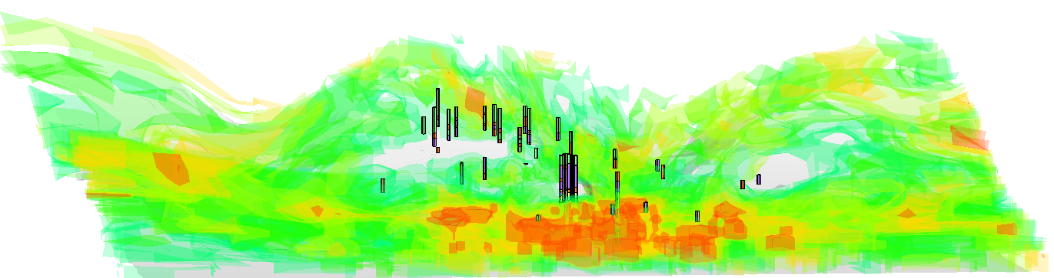
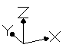
Cross sections
Sand
100%
75%
50%
25%
0
clay
Transitional
Probabilities
T-Progs
Equiprobable realizations 1, 2, 3, n, …
Sand
clay
Boreholes
data base
Sand
Domain
’
’
PUC - Cardozo de almeida
Angélica PACAEMBU
Mackenzie
x'
Sand
Z↓
Sesc Pompeia
Sand
clay
Perdizes
clay
y'
Sand
p_{j}
L_{k}
$$Beta μ$$
Notes:
The allocation of the materials inside the modelling domain is the primary inquiry being examined here.
“…
changing from a state of relatively indefinite, incoherent, homogeneity to a state of relatively definite, coherent, heterogeneity (Spencer 1820-1903)”, this is a discussion of concepts as lateral continuity, juxtaposition’s tendencies, recurrence, frequency and average lengths of the observed hydrofacies, from an 120 boreholes database.
…
In this manner we deal with uncertainties, related (let’s say), to the organic content’s of clayey material in a future reactive transportation model, for instance.
This is a question of interpolation, of interpretation, cause we know that the depositional process is seldom seen in the simpler layer cake mode.

Slide 5
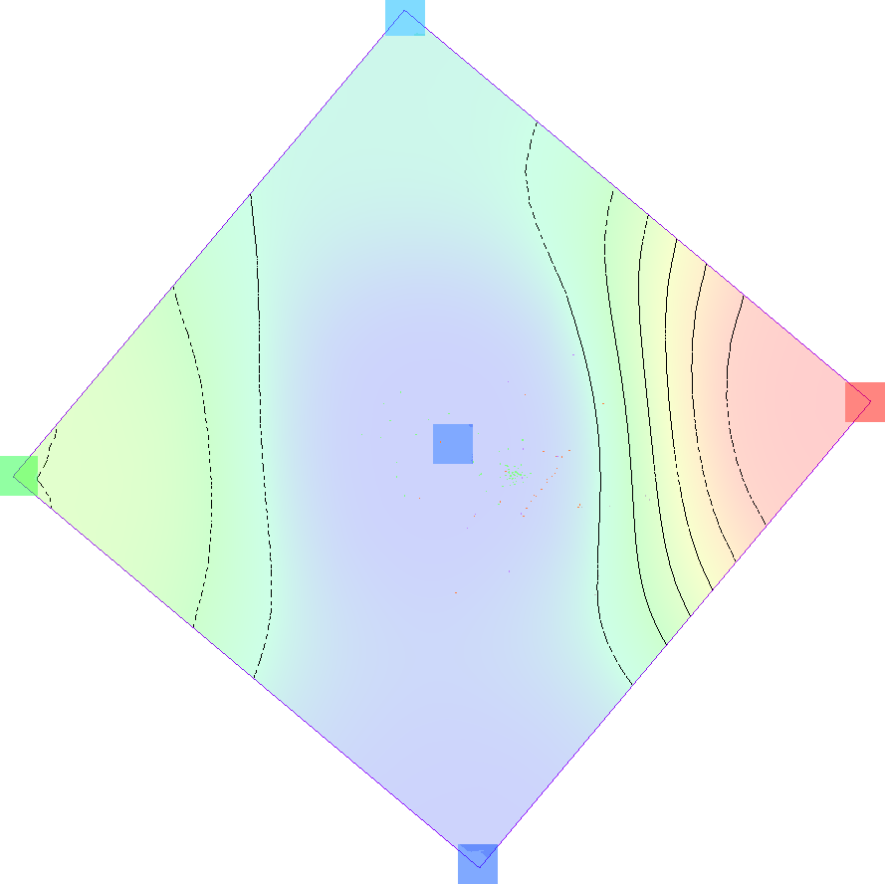
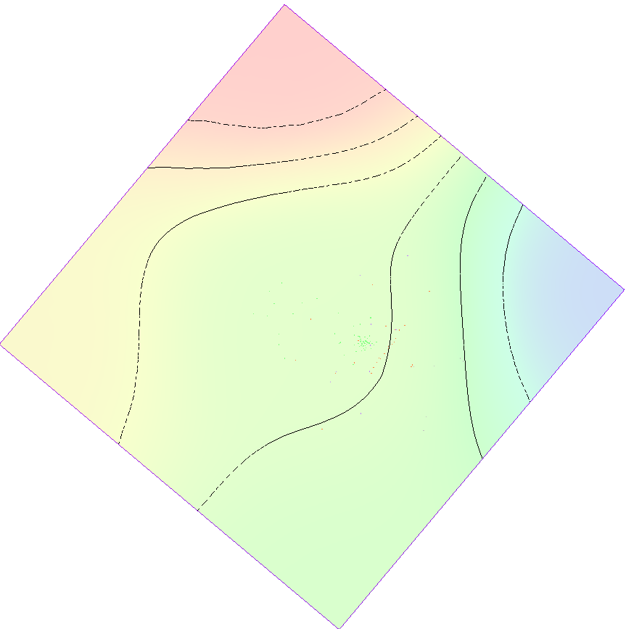
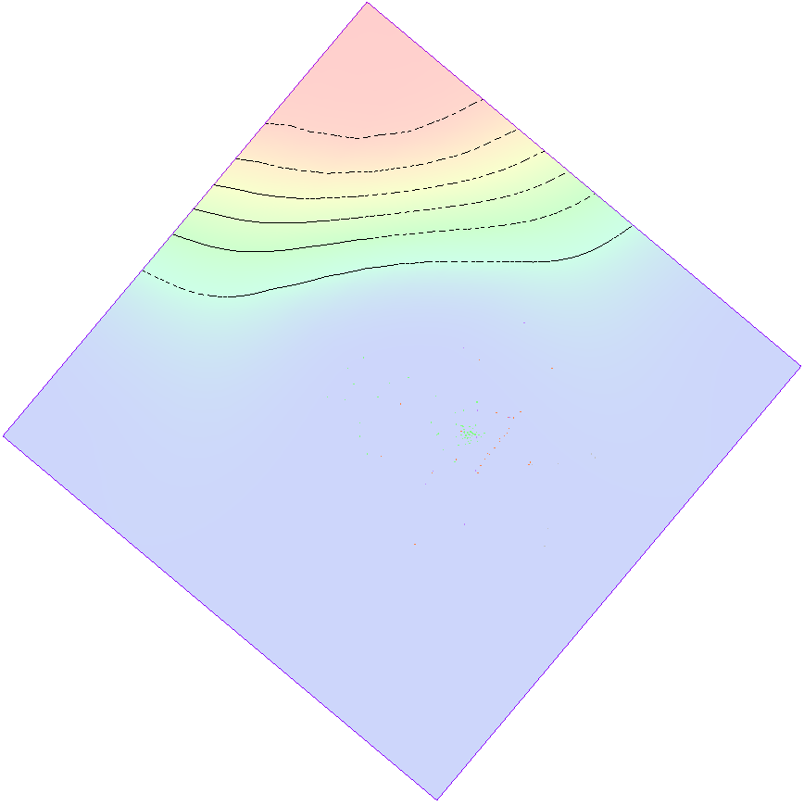
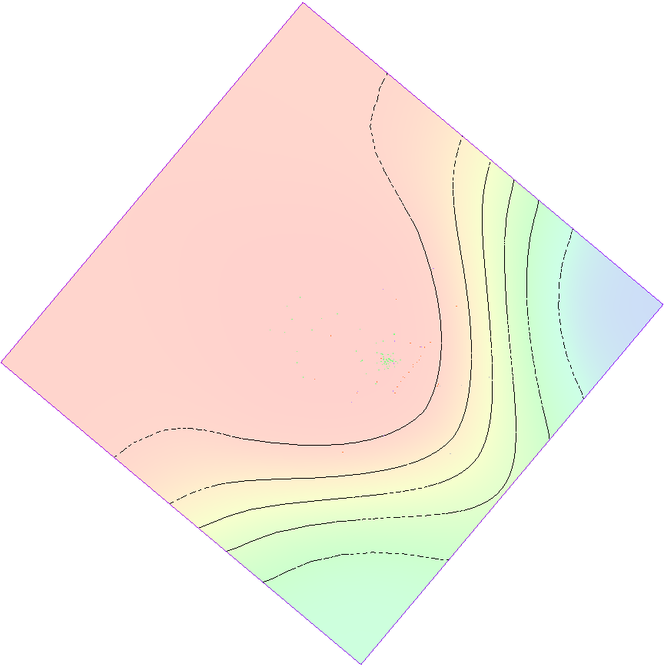
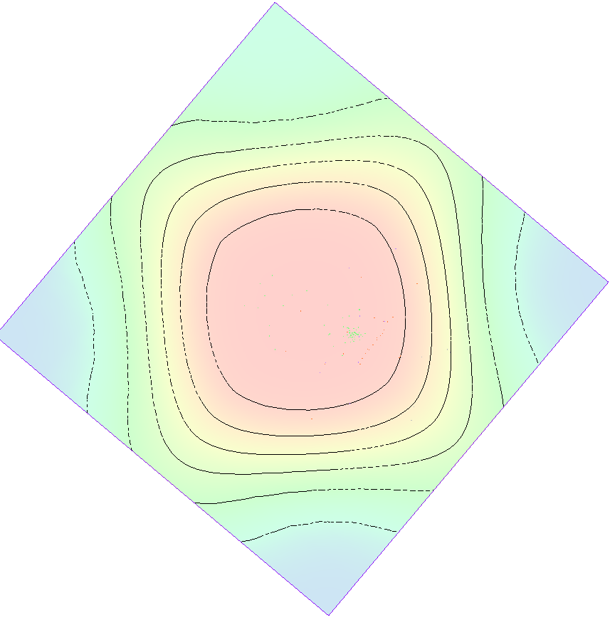
Pilot points
Parameters
MIN (cm/s )
MAX
S
c
S
c
S
1, 2, 3, 4, 5
Sensibilities
KH ^{10%}
(m/d)
KV ^{90%}
(m/d)
(m/d)
# K ref.
Hydraulic Conductivities referentials (m/d)
# K_{1,2,3,4,5} multiplied by Horizontal end Vertical anisotropy coefficient’s (aH, aV)
05 Pilot points
each hydrofacies
Inverse distances interpolation
Hydraulic conductivities physical distribution, parameters selection,
pilot points…
T-Progs & PEST.
Geological Conceptual Model
Frequencies p_{j}
Lengths L_{k} (Z)
Lenths L_{j} (x,y)
PUC - Cardozo de almeida
Angélica PACAEMBU
Mackenzie
x'
Sand
Z↓
Sesc Pompeia
Sand
clay
Perdizes
clay
y'
Sand
p_{j}
L_{k}
$$Beta μ$$
Notes:
Uncertainty, again. - Unfortunately we can’t deal with the modelling of Hydraulic Conductivities (K_{1,2,3,4,5}), without contemplating the problem as a whole, without the careful consideration of how these materials got itself “physically” dispersed in the modelling domain, in the first place,
…
On top of that (in this and many other cases as well), there is the need of further rearrangements much better achievable by the interpolations of the pilot point strategy, with chooses the better combination of K in and its correlation with Horizontal end Vertical anisotropy coefficient’s (aH_HANI, aV_VANI), …
…
Knowing that this hydraulic conductivities estimations are connected with all boundary conditions selection and parametrization. Plus, keeping in mind that each of these decisions are an indelible consequence of prior expectations embedded in the objectives function definition of any model calibration exercise.

Slide 6
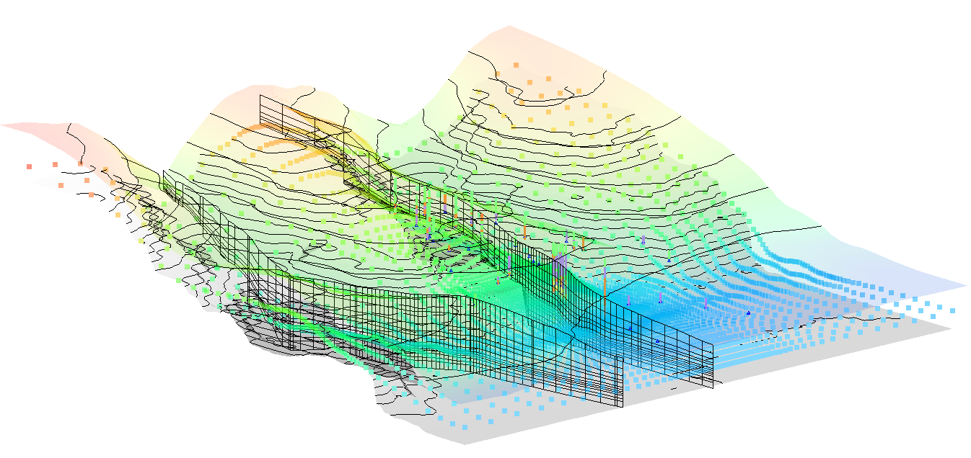
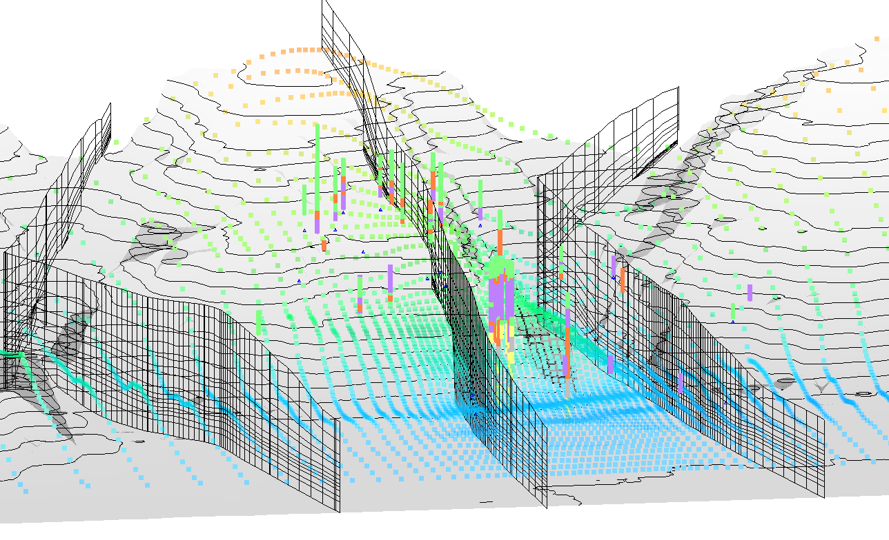
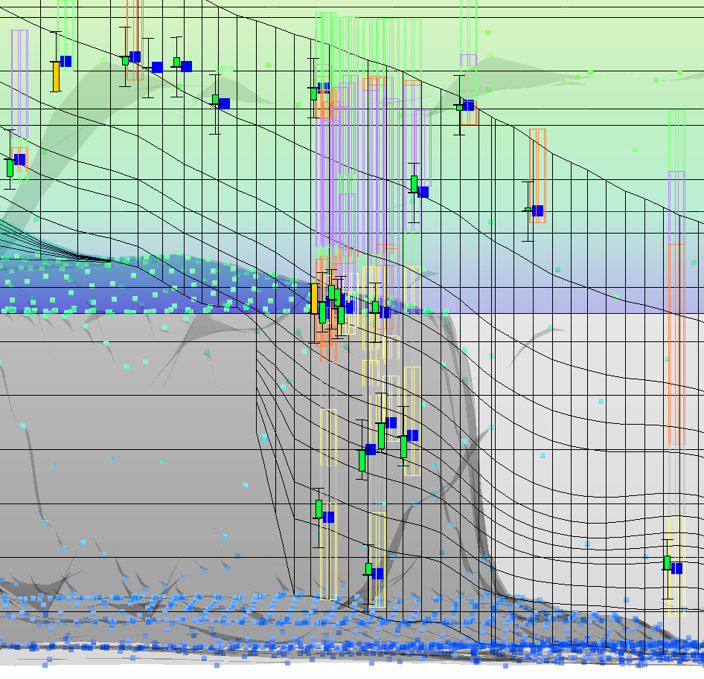
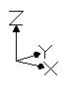
Hydrogeological
1
Upper and
Bottom surfaces
no Mid surface upstream
3
Upper
Mid
Bottom surfaces
1
2
3
1
Conceptual Model
Theoretical and practical …
2
… findings:
3
GHB.1
Aquitard
GHB.2
Manageable H₂o income
$$Beta μ$$
Notes:
At first a solution was thought for two separated instances. This move, detaching the São Paulo and Resende formations / aquifers, inspired the aquitard proposition.
…
The lower bottom surface follows the borehole maximum depths and the topography. Then a discretization initial effort tried to emulate this supposed regional discontinuity at the 6th numerical layer (out of 12). A feature accomplished by offsetting the conspicuous topographical lines till a probable retrograde erosion surface, following the two gorges greater erosion advance capabilities at the runoff superficial water path lines.
…
But then the parameter selection phase – guided by the observed targets – required an extra water GHB intake as a way to put enough pressure at the deepest hydraulic heads. Then again just until a certain point, to preserve the low heads at shallow aquifer... It honored the anticipated ascensional groundwater flow pattern.

Slide 7
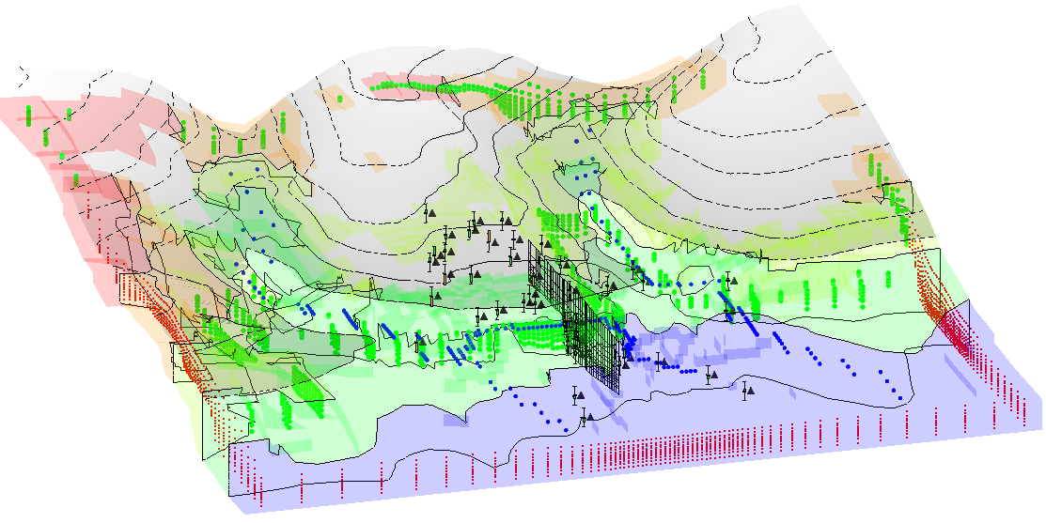
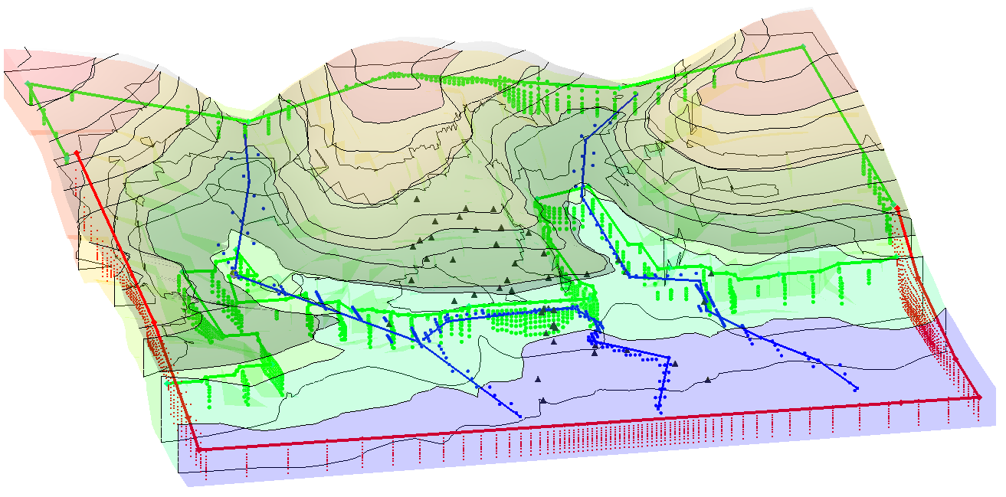
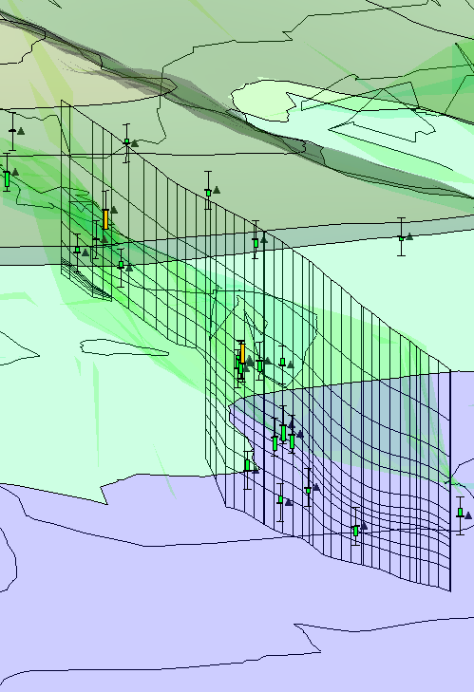
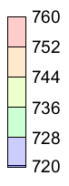
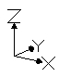
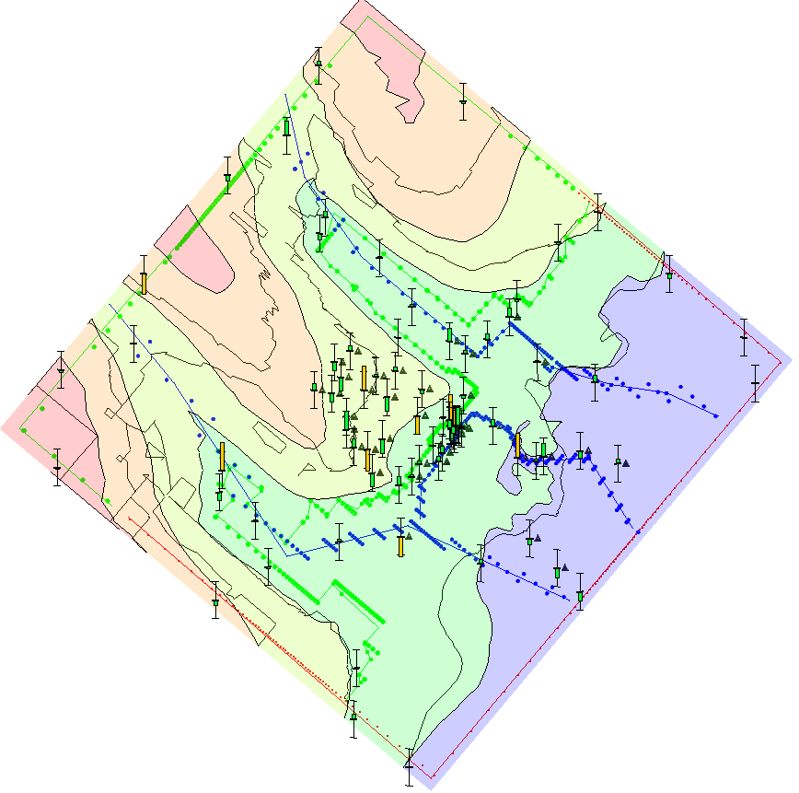
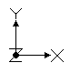
Boundaries:
Remember
that?
DRN GHB CHD
GHB_1
GHB_1
DRNs
Heads
GHB_2
CHD
Drains
Results:
GHB boundaries elevations, positions
The flux model won't be suitable for predictions until calibrated.
So then, transport: pumping tests,
transient scenarios, MT3D, PHREEQC, ...
$$Beta μ$$
Notes:
These outcomes are accompanied by the usual mass balance and acceptable MSE / RMSE errors, calibration details to be brought up in a later discussion.
…
According to the theoretical, hydrological modelling conceptions, this scenario must defend the enforcement of the following site specific rules:
- The water must leave the domain by the CHD boundary, not the other way around;
- Some deep water can justifiably being added in tandem with the 3.5 Km long plato uphill, if consideration has been given to the evident water table depletion induced by the two excavated gorges in place.
…
Let's expand this conversation by adding a few theoretical justifications in between.

Slide 8
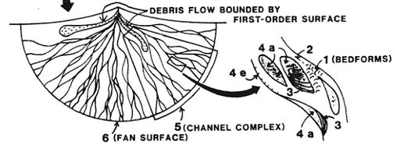
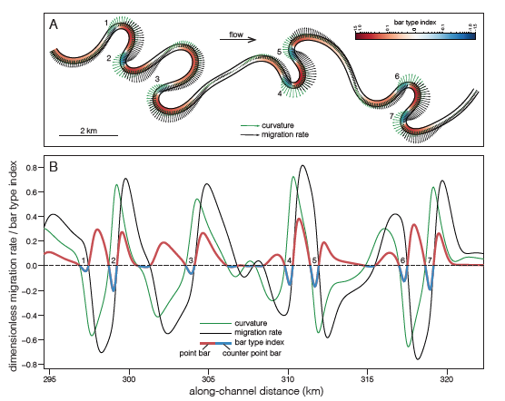
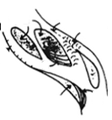
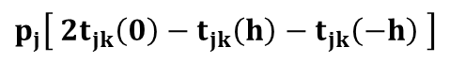
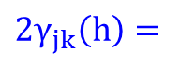
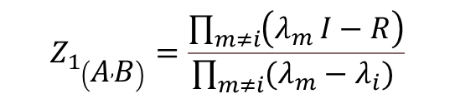
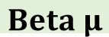



Theoretically …
↓ The borehole
The sedimentology
Miall (1996), Sylvester et. al. (2019)
C
A
C
A
B
C
A
B
C
A
The math’s
$T\left(h_{∅}\right)=$ $exp⁡({R_{∅}h}_{∅})$
$$Te\left(h\right)=\sum_{k=1}^{K}{θ_{k}({\left.Δh\right)}^{h/Δh})Z_{1}}$$
$$Z_{1_{\left(A , B\right)}}=\frac{\left.\prod_{m≠i}{\left(λ_{m}\right.}I−R\right)}{\prod_{m≠i}{(λ_{m}−λ_{i})} }$$
2 km
Curvature
Migration rate
Cycles
Alluvial Fan
Cycles
$$2γ_{jk}\left(h\right)=$$
$$p_{j}\left[ 2t_{jk}\left(0\right)−t_{jk}\left(h\right)−t_{jk}\left(−h\right) \right]$$
$$T=\left[\begin{matrix}t_{\begin{aligned}AB \\ \end{aligned}} \\ \begin{matrix}⋮ \\ t_{KA}\end{matrix}\end{matrix} \begin{matrix}⋯ \\ \begin{matrix}⋱ \\ ⋯\end{matrix}\end{matrix} \begin{matrix}t_{\begin{aligned}AK \\ \end{aligned}} \\ \begin{matrix}⋮ \\ t_{KK}\end{matrix}\end{matrix}\begin{matrix} \\ \end{matrix}\begin{matrix} \\ \end{matrix}\right]$$
Variogram = Transiogram
Rivers
Point bar
Counter point
Man, stop!
T-Progs uses an innately cyclical notation to describe the depositional phenomenon's seasonal, rhythmic nature.
| T | | A | B | C |  | ∑ _{j} =
A | t_{AA} | t_{AB} | t_{AC} |  | 100%
B | t_{BA} | t_{BB} | t_{BC} |  | 100%
C | t_{CA} | t_{CB} | t_{CC} |  | 100%
A
B
… the
meaning:
- Cyclicity.
C
We need this to fill the modeling domain.
$$Beta μ$$
Notes:
T-Progs responds for Transitional Probability Software. It operates on a dual analysis of both geostatistic and sedimentological principles.
…
- It extracts information from an 2D borehole database;
- And describes these database contents in a very powerful way, the matrixial notation of transiograms | Γ | T(Δh) | | .
…
T-Progs makes all of its measurements fully available to some required adjustments, depending on the user interpretation for different case scenarios.
Afterwords, it implements stochastic 3D interpolations in order to infer the unknow contents for the whole modelling domain. That is to say, to determine the most probable hydrofacies distribution for the vast majority of the cells that did not got the opportunity to be set as one of the sampled (fixed) points.

Slide 9






Theoretically …
An exercise:
For a (10m in diameter) doted size 1D version of our database:
In our own,
current
scenario,
actually.
x’
2D (x,y)
equiprobable
resolutions
250
y’
400
m
2D
10 m
1D
dataset
points
Recurrence probabilities
2D dataset, boreholes
Frequencies
p_{j} (%)
Lengths L_{k} (m)
x'
Sand
Z↓
10x (Z →x,y)
clay
L_{k} (m), idle info
in a xy scenario
y'
Sand
Langousis - Markov (2018)
clay
Sand
S c S c S
$$Beta μ$$
Notes:
The method permits user interventions on any independent hydrofacies or direction, despite the fact that the outcome is a weighted combination of all the involved factors. “Dealing with spatial heterogeneity (de Marsily et, all. 2005)”, T-Progs implements an estimation process analogous to or compatible with the geostatistics rules of spatial variances, which normally follows the cokriging of categorical covariables, in extension, based in variograms or semi variograms ($2γ_{jk}$).
…
Getting back on track: - We are talking about the flux of … sediments. At this GRU site we need plenty more of the Resende Formation yellow sandy hydrofacies in the x’ direction. And quite a bit of associated grey [clay] as well. But it would be suitable also to have more of (fresh) green sandy hydrofacies coming from the uppermost perpendicular recent erosion process in the y’ direction. T-Progs acts accordingly.
Thus we see why there is greater yellow facies recurrence probabilities in y’, and not so unexpectedly, after (below) the orange (S) sandy ones.

Slide 10






Theoretically …
Borehole
Σ
Σ
Σ
• • •
$$\sum_{i=1}^{K}{exp \left(λ_{i}h\right){ Z}_{i}}$$
100%
Transition rates
$$α=r_{π}=\frac{∂t_{jk}\left(h→0\right)}{∂h_{z}}$$
Sample
A
↑
A
J
↑
A
J ↑ K
t_{jk}
• • •
→ Probabilities (%)
α
sample walking
p_{j} (%)
→ steps
|AA|
n₂
• • •
Frequency
n₁
0
L_{k} (m)
→ distance
n₀
→ distance ‘h_{z}’ (m)
Length
Γ | A | B | C
A
B
C
|AA|
|AB|
|AC|
Δh = Unity
Transitional Probabilities
The transiogram
T-Progs compute frequencies and average lengths of all observed materials as a indirect measure of its reoccurrence in depth (z↓).
Then reproject this findings in 3D, through Walther’s Law.
|BB|
|CC|
$$Beta μ$$
Notes:
T-Progs operates with the matrixial notation of an 2D regionalized type of database, the borehole.
It collets the data sequence (in a bottom-up direction), … varying its steps ( h_{n} ) … and distances (Δh), in order to represent vertically oriented transitions probabilities.
It’s a bit trick to understand, but after matrixial accountings | T_{jk} | and unfathomable mathematical handilings, it rests on a matrix of charts, the transiogram | Γ |.
Remembering from the Euclidean geometry: A vector is a linear (2D) array of quantities. When a matrix has only one row or only one column it is called a vector.
…
Here all the observations comes in a very condensed form: The so called [covariance matrix] main diagonal elements | t_{jj} | got the hydrofacies continuity in a given direction. While its remaining | t_{jk} | elements responds for the (transitional) probabilities to see changes of a hydrofacies of reference to another.
The algorism compiles an unique equation, then transfers these guidelines to the remaing cardinal directions (x, y), after Walther’s Law classical principles.

Slide 11








Theoretically …
| Tprogs|
Borehole
Littre wonder, this variables are called spectral components (σ).
$$\text{A} \text{∗} X=B$$
$$λ \text{∗} X=B$$
$$\left[\begin{matrix}a_{11}−λ & a_{12} \\ a_{12} & a_{22}−λ\end{matrix}\right]$$
Scalar factor
$$\left(A ∗X\right)−\left(λ∗X\right)=0$$
$$\left(A−λI\right) X=0$$
$$\left|A−λI\right|=0$$
$$λ_{1,2}=\frac{−p_{1}±\sqrt{{p_{1}}^{2}−4p_{0}}}{2}$$
5
4
3
2
1
0
-1
-2
-3
-4
-5
$$\left[\begin{matrix}σ_{A} & 0 \\ 0 & σ_{B}\end{matrix}\right]$$
Davis (1973)
$T\left(h_{∅}\right)=$ $\underline{exp} ⁡({R_{∅}h}_{∅})$
σ_{B}
Φ
T-Progs relies on
exponentiation.
… of underlying.
Eigenvalues &
Eigenvectors
( σ_{A,B} , V_{1,2} )
σ_{A}
$$\left[\begin{matrix}\cos_{θ} & {−sin}_{θ} \\ \sin_{θ} & \cos_{θ}\end{matrix}\right]$$
- - - - -
54321012345
Stretching & Rotation, that’s all it does.
$$Beta μ$$
Notes:
For the synthetic combination above, all the information stored at this didactical 84848 binary kind of borehole has been rendered in the 2 x 2 simplest matrixial format.
…
In order to predict the next material, let’s say, 40 unities below the starting point (Δh→0), or beyond, T-Progs works the matrixial potentiation of | T | ^{n}.
The average odds are 26%A, 74%B.
Note that the original experimental curve (dotted red) and the exponential one (dotted black) only succeeds in finding the probabilities for certain categorical distances.
…
So instead of working the true matrixial elements, the algorithm process commonplace fundamental mathematical relationships within any matrixial formulation.

Slide 12












Theoretically …
| MODFLOW | PEST | Tprogs|
Doherty’s SVD
What is a
numerical model (?)
$\left[\begin{matrix}1 & 2 \\ 3 & 4\end{matrix}\right]$ = $\left[\begin{matrix}\cos_{θ} & {−sin}_{θ} \\ \sin_{θ} & \cos_{θ}\end{matrix}\right] \left[\begin{matrix}σ_{A} & 0 \\ 0 & σ_{B}\end{matrix}\right] \left[\begin{matrix}\cos_{θ} & {−sin}_{θ} \\ \sin_{θ} & \cos_{θ}\end{matrix}\right]$
A “huge” matrixial representation
of all the stresses and boundary conditions.
What’s for sale here is how useful information can be mined, transferred from observations to the parameters dataset.
PCG2 - USGS
Then comes the inverse problem:
From PEST we have parameters selection & sensibilities.
OBS
Essentially MODFLOW is just a medium,
a virtual portrait connecting parameters to observations
PAR
$Null space$
v₃
$Solution space$
$$A∗x=b$$
$${x=A}^{−1}∗b$$
$\underline{\hat{k}}$
$\underline{k}$
Cause we need to learn from this connection.
Next, the final report of all taken decisions, accounts and findings:
Database 1
Dataset 2
v₂
$$\underline{h}=Z \underline{p}{+ }^{ε}$$
v₁
errors
$$Beta μ$$
Notes:
For those who have followed along with these arguments thus far, this eigenvalues | eigenvectors introduction has intentionally been displayed in this level of detail here, to emphasize the use of the same principals by T-Progs, MODFLOW and PEST.
- It implies that is always worth to keep in mind the cyclical nature of the matrixial relationships. I.e.: That any modification on the parameter dataset (should) lead to many variations on the results, the observation / compiled dataset. Or vice versa, that any pursued observational dataset expectation, or combination of targets / expressions, must be addressed by some form of parameter or structural measure, accordingly ..
- This is just as an expedite introduction of how the present GRU project benefits from the use of PEST methodology, just as it has profited from T-Progs.
...
The mathematical regularization, or how the parameters were chosen, and doing so, the consequences of this choices, comes in the next two pages GRU report.

Slide 13

Getting back on our track: GRU
SEN_
PAR (x)
Last realization bayesian targets.
Aside, the sensibilities.
Heads
DRN GHB CHD
SEO
K_{1.2.3.4.5}
aH | aV
Diference_Obs
Concern:
clay
Changes | values | SEN
SEN
PAR
x
SEO
OBS
SEN
Diference_Par
$$Beta μ$$
Notes:
Covariance Matrix, Singular Value Decomposition, the degenerative transformation that deals with the high dimensionality curse, Parameter Space, Null Space, etc.
All those concepts were used in the semi automatised task of choosing the best possible combination of modelling design and parametrization of a given context. With the aim to replicate, numerically, the best set of compiled results which, in its turn, tries to be in a close enough range regarding the true observation database.
…
– The results of this GRU report brings calibrated Hydraulic Heads. And in extension a god estimative of all the modelled fluxes involved. Comes along a set of interrelated information’s used to ascertain that every decision was made using a minimum burden of discrepancy to avoid biased results. Through sensibilities.
For example: These charts points out on purpose the aV parameter high deviation for the second upper clay (0.01) hydrofacies (aV₂). More attention must be paid here.
- Besides, this is a stochastic process. Alternative, similar results are readily available, just changing the T-Progs realization of a new model - easily re-calibrable.

Slide 14
Getting back on our track: GRU
Following the objective function idealization this, variables place limits on both the parameters ranges acceptable deviations and observation heads | fluxes.
(m)
MED
MOD
m³/d
Here only the RMSE on heads (9%) has a meaningful content, since the others errors accompanies simple estimations.
Parameters
m³/d
Observations
This mass balance summary testifies this solution accuracy.
(m³/d)
IN
OUT
Mass Balance
$$Beta μ$$
Notes:
Final notes:
The solely GRU calibration case reference points comes down to a database of 47 useful monitored hydraulic heads, as well as conductivities estimations from a couple of pumping tests. Here 35 heads, 74% of it were respected in its pristine real contents, but 7 shallow observations received slightly modifications in order to compensate recent soil subtraction of remediation interventions. And 5 other heads received little adjustments because wide variations on respect to close neighbors were identified.
…
- This project is a debt I’m paying to myself, perhaps also to the real owners of the costly borehole database. And in extension to the investment of GMS | Aquaveo, the software company who patienctly allowed these studies endeavors, indeed a remake of my master’s thesis back there in 2020 at CEPAS | IGC | USP.
- If you found this text interesting, consider hitting the like bottom or leave a comment. The database and all needed, related info can be found at www.betami.com.br
Thank you.
RMG
08/2024

